Slide 1

Mounting of LMS251/5XX with wall mounting bracket
Speaker, Location

Slide 2
Agenda
Post and wall mounting bracket for LMS251/5xx necessary components
Second Topic
Subline
Subline
Third Topic
Fourth Topic
Subline
Fifth Topic
Sixth Topic

Slide 3
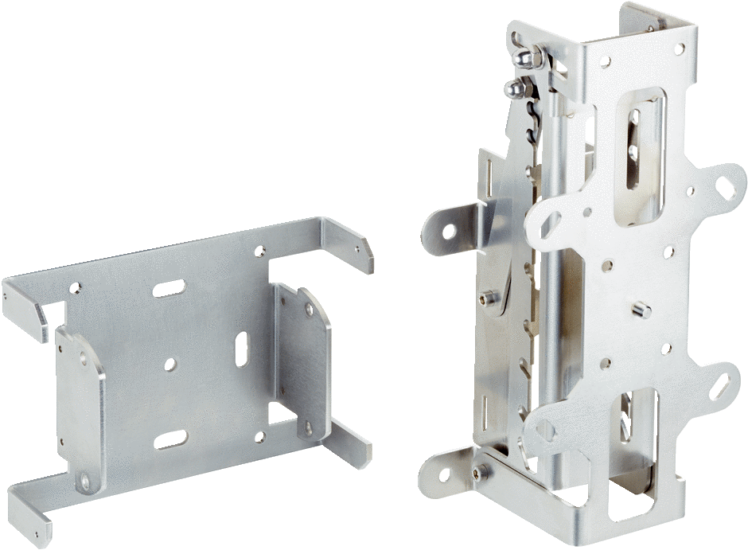
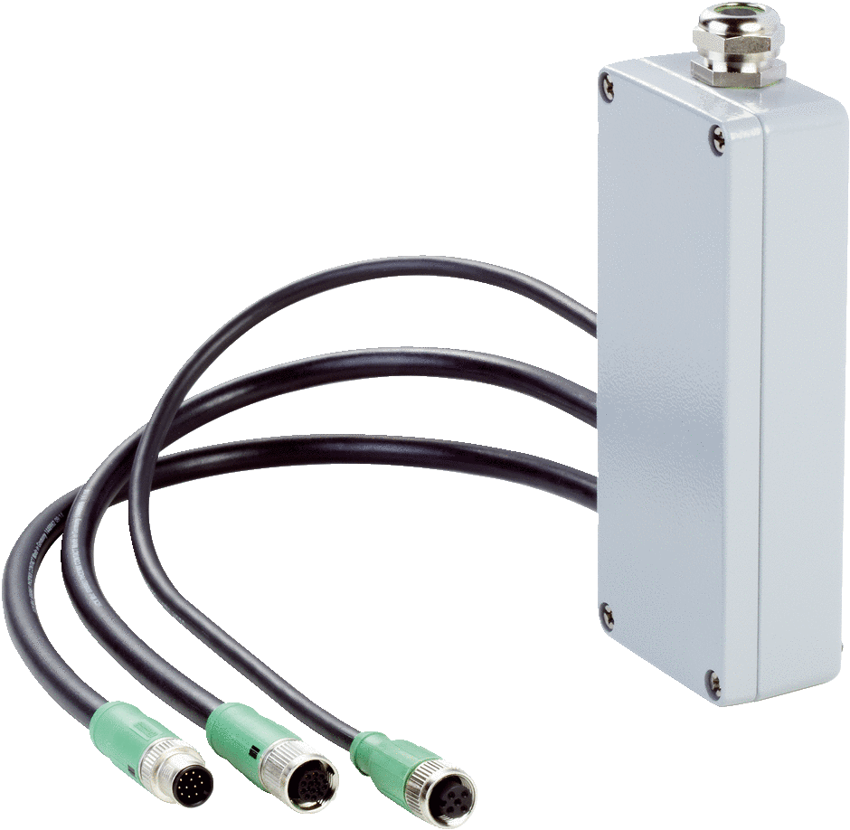
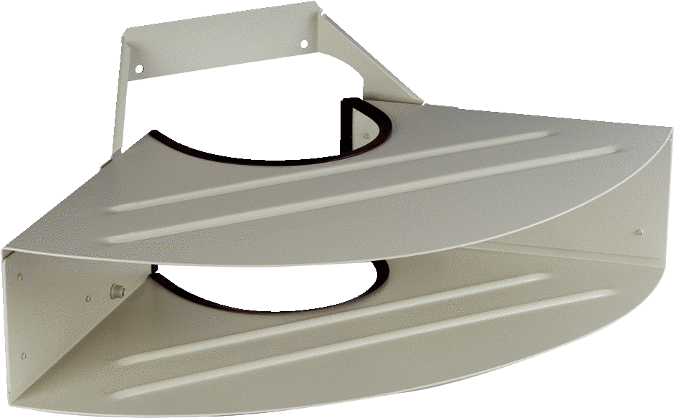
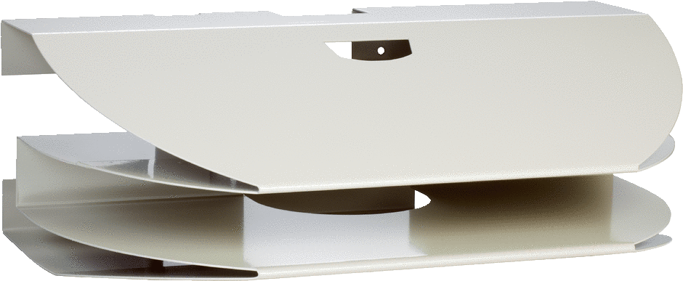
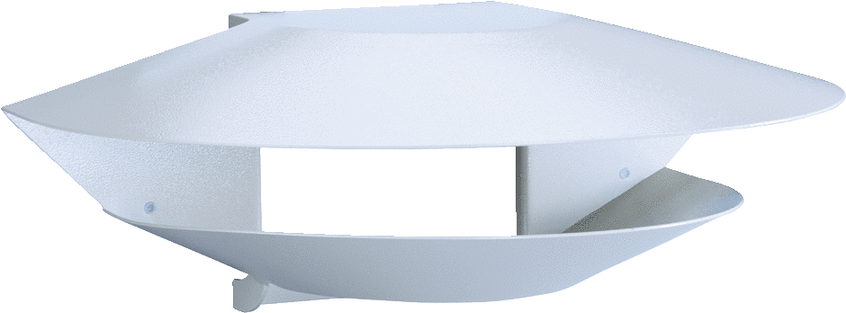
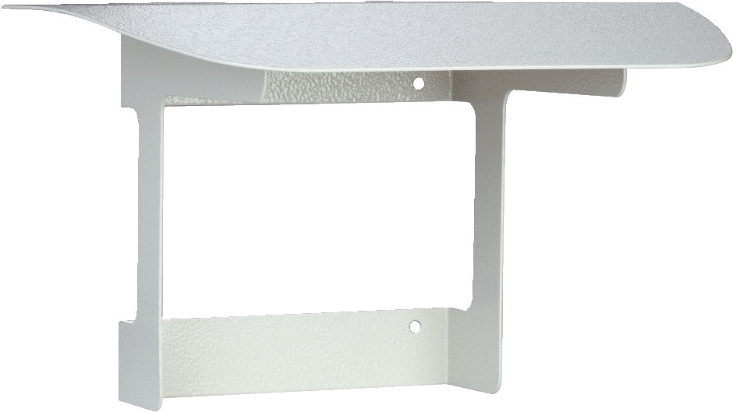
Post and wall mounting bracket for LMS251/5xx necessary components
Post/wall bracket for LMS251/5xx:
Order No: 1081412
Weather hood for LMS251/5xx
Order No:
Weather hood 180°: 2063050
Weather hood 190°: 2089593
Weather hood 125°: 2026151
Sun hood: 2056850
Optional Connection box:
Order No:
For LMS531: 2079824
For LMS511 Pro: 2063034
For LMS511 Lite: 2062346
For LMS251: 2063074
For LMS511 HD (Heavy Duty): 2095789

Slide 4
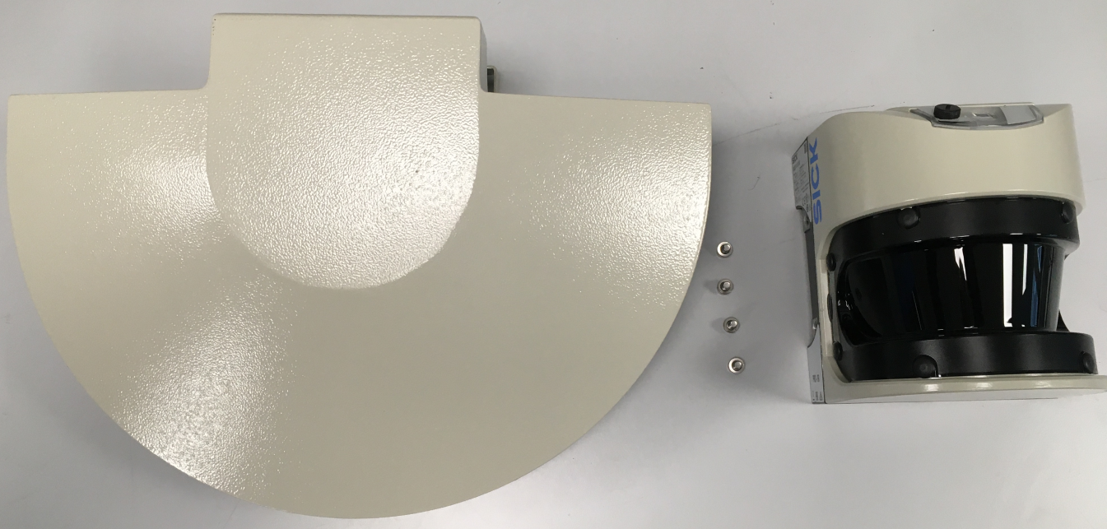
Mounting the weather hood

Slide 5
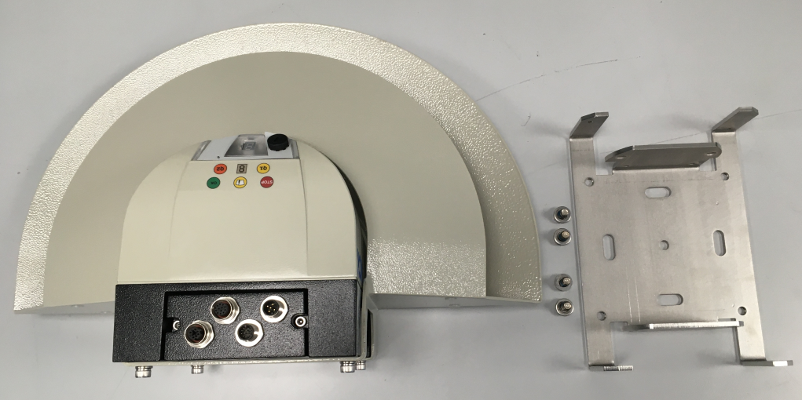
Mounting 1.Part of the bracket

Slide 6
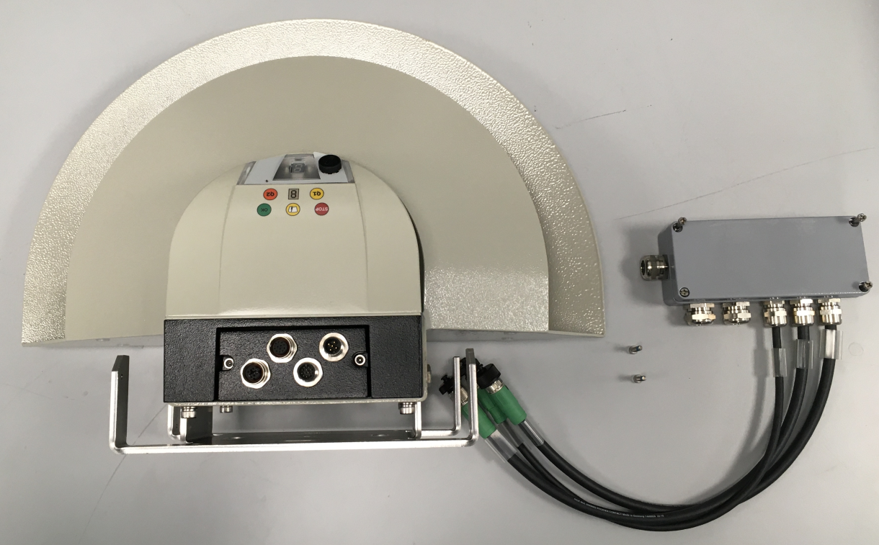
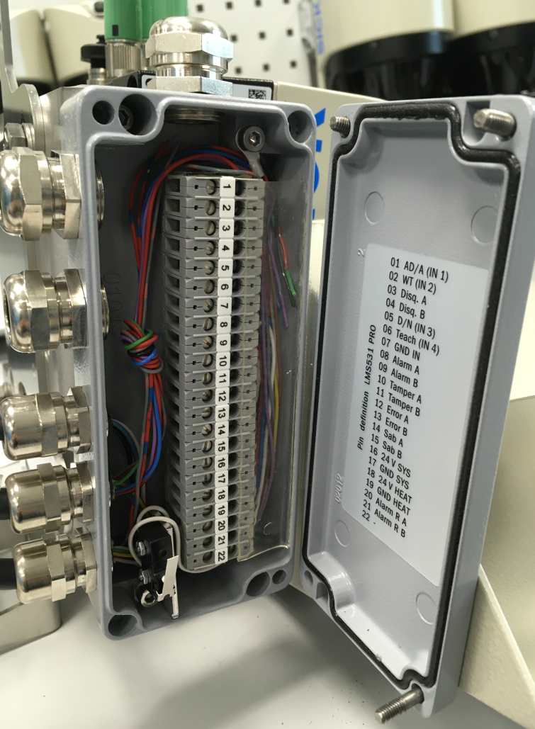
Mounting the optional connection box

Slide 7
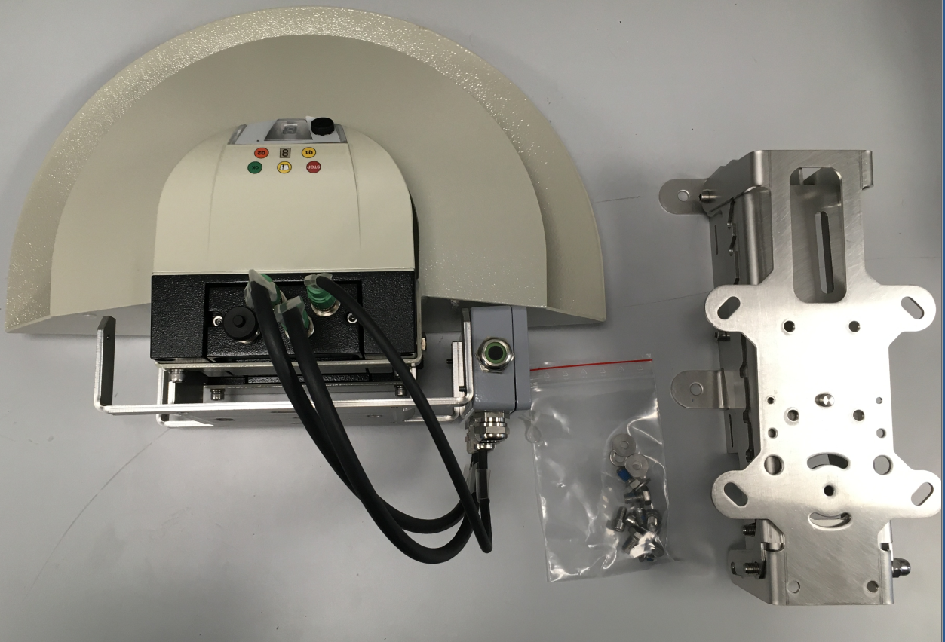
Mounting 2. Part of the bracket

Slide 8

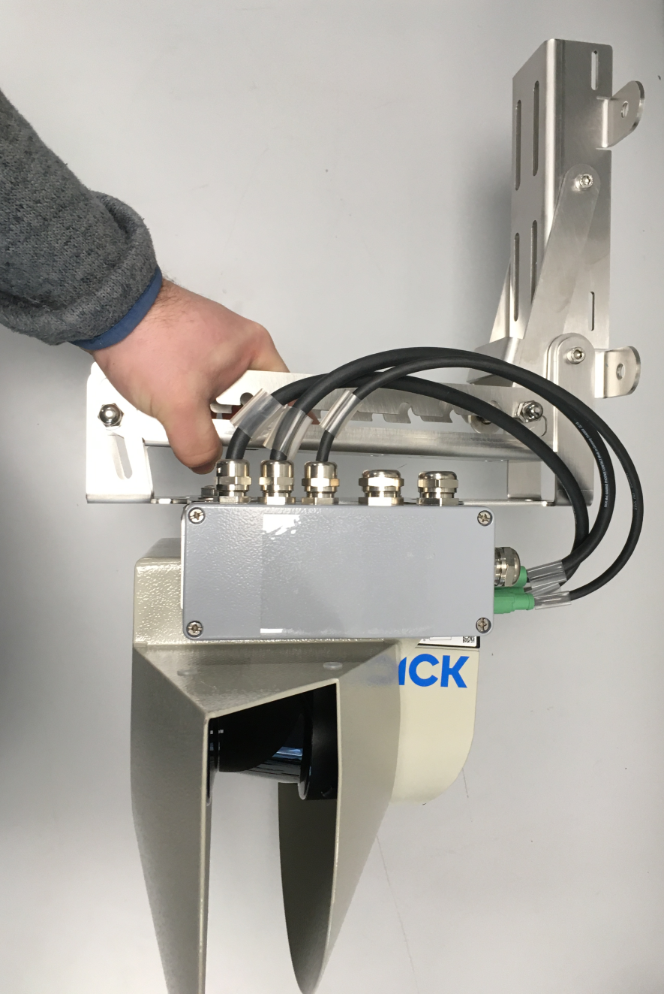
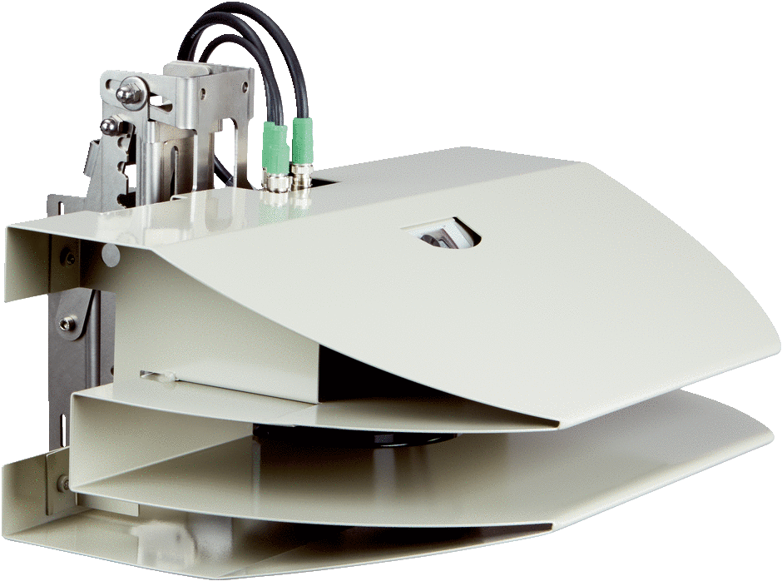

Finished mounting bracket for post or wall mounting

Slide 9

Information (1/3)
Text layers
First text layer for running text (Open Sans, 14 pt, black)
Second text layer for titles (Open Sans, bold, 14 pt, black)
Third text layer for bullet points (Open Sans, 14 pt, black)
Fourth text layer for bullet points (Open Sans, 14 pt, black)
Fifth text layer for numberings (Open Sans, 14 pt, black)
Sixth text layer for numberings (Open Sans, 14 pt, black)
Seventh text layer for numberings (Open Sans, 14 pt, black)
Eighth text layer for key messages (Open Sans, bold, 16 pt, Blue)
Ninth text layer for caption, footnotes (Open Sans, 10 pt, black)
Information
To change from one text layer to the next, use the Increase / Decrease List Level buttons:
Or with your keyboard: ALT+SHIFT+LEFT or RIGHT
Important
Do not use the normal bulletpoint or numbering function buttons.

Slide 10

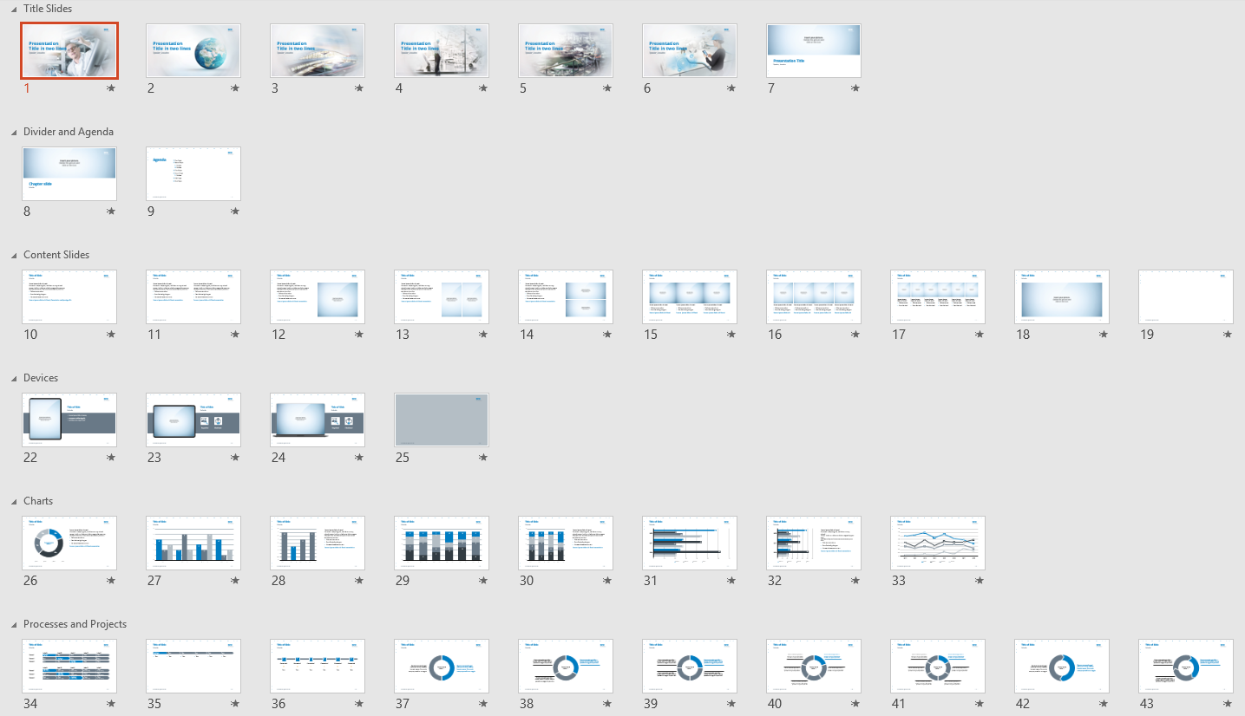
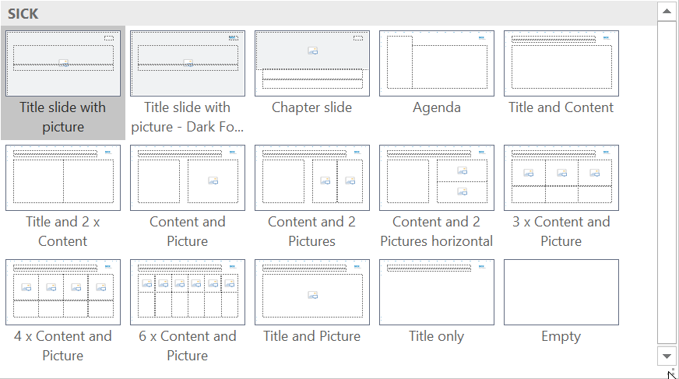
Information (1/3)
User guideline, Slide library, Slide layouts
User guideline
Please refer to the PowerPoint User Guideline for basic instruction and advanced tips and tricks.
Slide library
The slide library gives you a vast variety of different layouts, tables, graphs, charts, pictograms and more.
Slide layouts
You can choose between different slide layouts.
Click on the Home-tab > New Slide or Layout > and choose one out of the layouts.

Slide 11
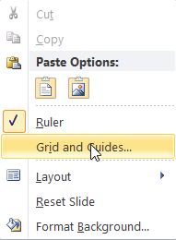
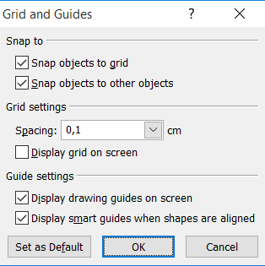
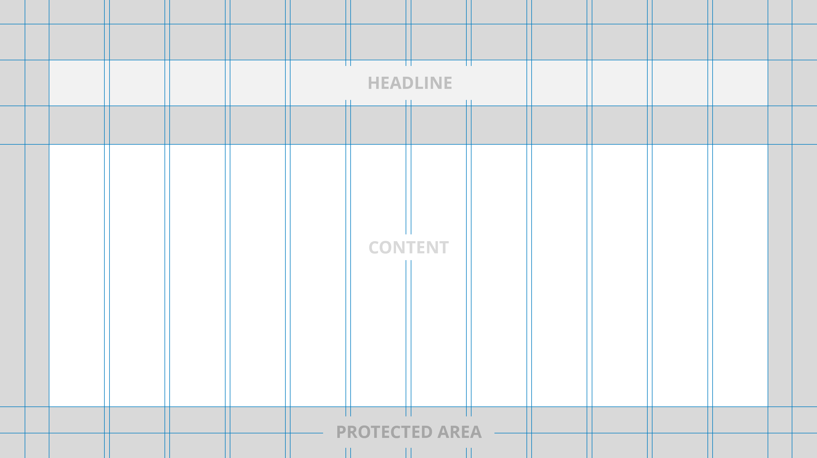
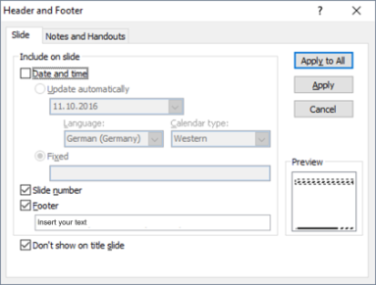
Information (1/3)
Drawing guides, Grid, Footer
Drawing guides
You can enable your guidelines to align objects on the slide.
Hit the right mouse button outside the slide and go at „Grid and Guides…“
Grid
Keep gaps on the left and the right-hand side. You can use squares for boxes or images.
Footer
You can insert or change your presentation‘s footer. Click on the Insert-tab > Header and Footer.
Deactivate Date and Time.

Slide 12
HEADLINE
CONTENT
PROTECTED AREA

