Slide 1
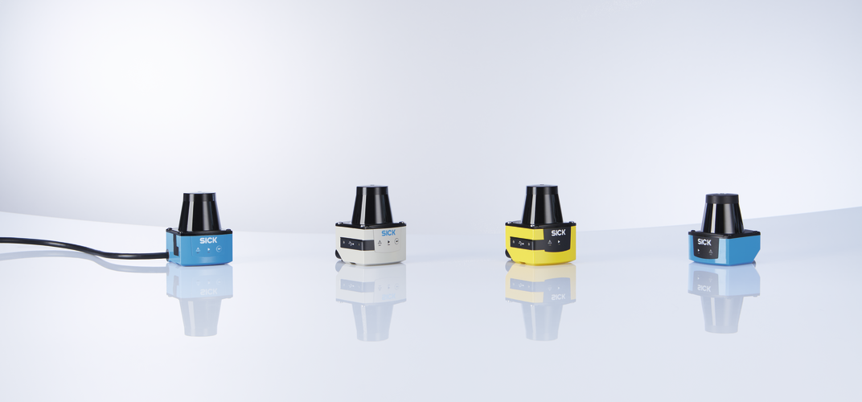

2d lidar sensors TiM3xx-7xx plane alignment
8PM/83
2019

Slide 2
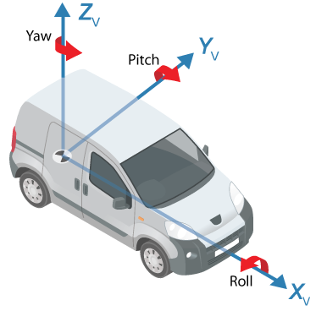
TiM3xx-7xx
Tolerance summary from the housing
Tolerance specification:
Our official specification is a kind of worst case scenario.
It is defined by the tolerance chain due to mounting of the mechanical components
Mounting
Mounting has a strong influence on the plane alignment.
Therefore we recommend using a mounting bracket with inbuilt adjustment. E.g.: https://www.sick.com/us/en/mounting-kit/p/p492344
Roll | Pitch | Yaw
± 3° |  | 1° for TiM551 0.33° for TiM571

Slide 3
TiM3xx-7xx
Modeling the laser emitter
Considering spot size
Considering spot size & laser divergence (9.5 mrad = ~0.544°)
Spot size @ screen = 6 mm
9.5/2 mrad = ~0.272°
9.5/2 mrad = ~0.272°
Spot size + divergence of 9.5mrad @ 250mm: ~8.4mm
Spot size + divergence of 9.5mrad @ 500mm: ~10.8mm
Spot size + divergence of 9.5mrad @ 10m: ~101mm

Slide 4
TiM3xx-7xx
Modeling the scan field flatness
Considering scan field flatness ±3°
3°
3°
Scan field flatness @ 250mm: 250 mm x tan(3°)= 13,1 mm
Scan field flatness @ 500 mm: 500 mm x tan(3°)= ~ 26,2 mm
Scan field flatness @ 10m: 10,000 mm x tan(3°)= ~524 mm

Slide 5
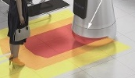
TiM3xx-7xx
Modeling the scan field flatness + laser emitter
Considering scan field flatness + spot size + divergence
WORST CASE Scenario (e.g. for desiging an light output slot )
3°
3°
½ Spot size @ screen = 3 mm
9.5 mrad = ~0.544°
@ 250mm distance
Scan field flatness 250 mm x tan3°: ~13,1 mm
+ ½ Spot size @ screen : 3 mm
+ divergence of ½ 9.5mrad: ~1.2 mm
= ~ 17.3 mm
@ 500 mm distance
Scan field flatness 500 mm x tan 3°: ~26,2 mm + ½ Spot size: 3 mm + divergence of ½ 9.5mrad: ~2.4 mm
= ~ 31,6 mm
@ 10,000 mm distance
Scan field flatness 10,000 mm x tan(3°)= ~524 mm + ½ Spot size 3 mm +divergence of ½ 9.5mrad:~47,5 mm
= ~574,5 mm

Slide 6
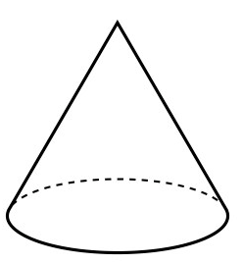

Possible Misalignments
The preceding explanations and calculations may be expressed in the following two effects.
Cone (e.g. due to internal misalignment of components)
Tilt plane (e.g. due to internal misalignment of components)
This can be compensated with the alignment bracket (https://www.sick.com/us/en/mounting-kit/p/p492344)
Effects can be mixed

Slide 7
Many thanks for your attention.
8PM/83

