Slide 1
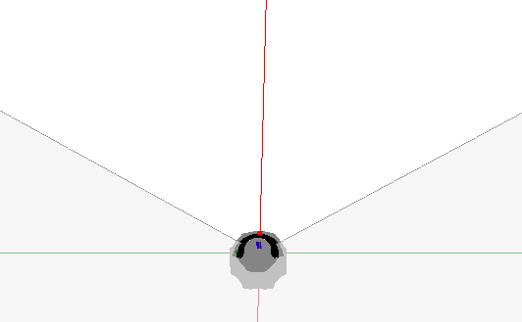
MRS6xxx
Quantization effect(distance resolution)
Distance measurement provides data in about 6cm steps.

Slide 2
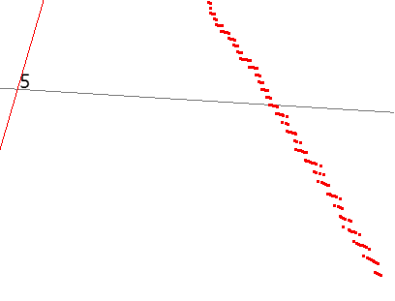
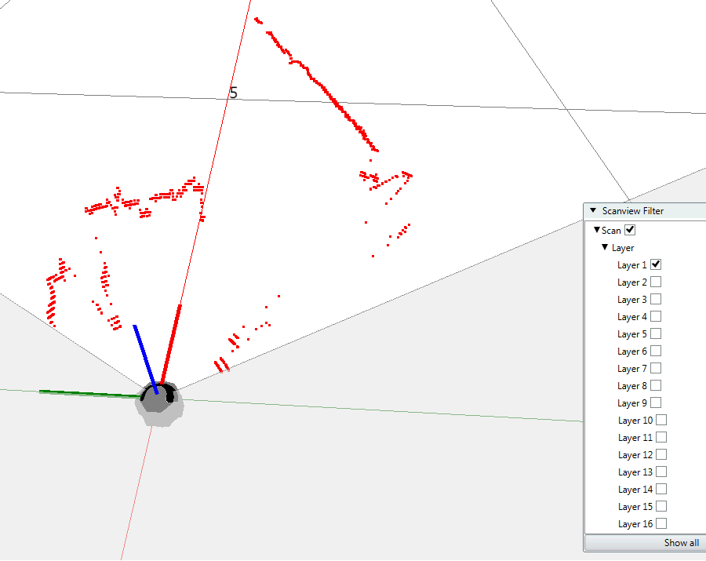
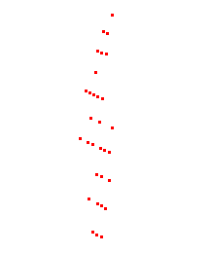
MRS6xxx
Quantization Effect example(distance resolution)
Zoom in
Zoom in more
To simplify the situation, only one layer is selected to illustrate the effect.
More visible in the near range.

