Slide 1
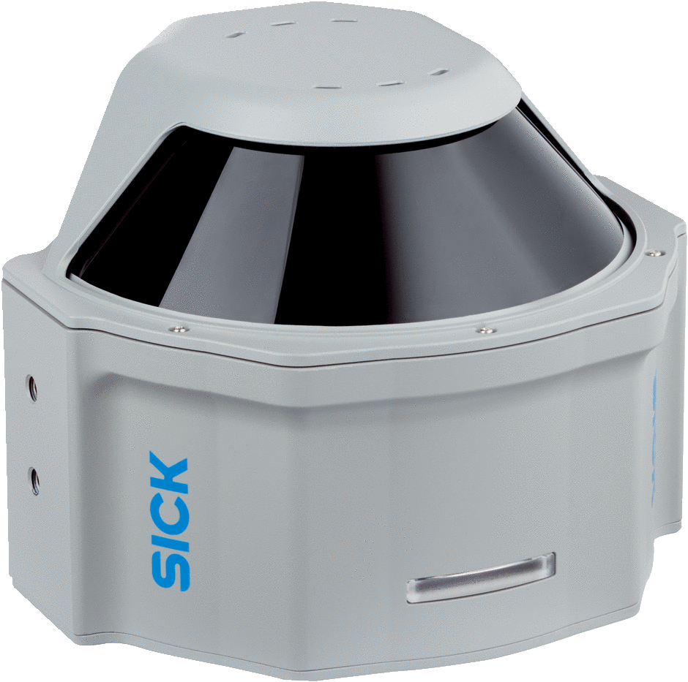
MRS6000 Mounting accessories
T. Wienk 02.09.2022

Slide 2
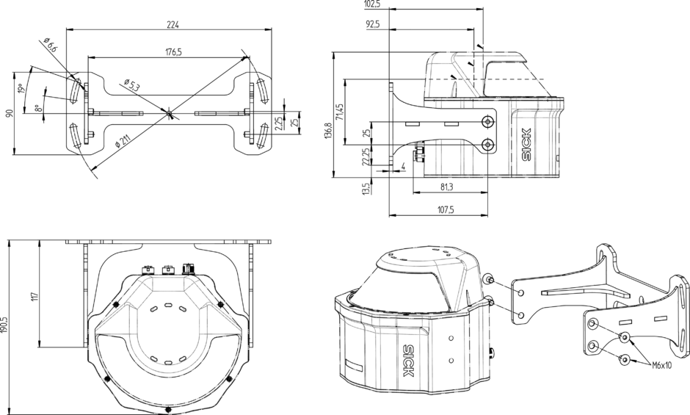

Mounting kit 2102120 for rear mounting
Mounting kit
Part no.:
    2102120
Description:
    MRS6000 bracket

Slide 3
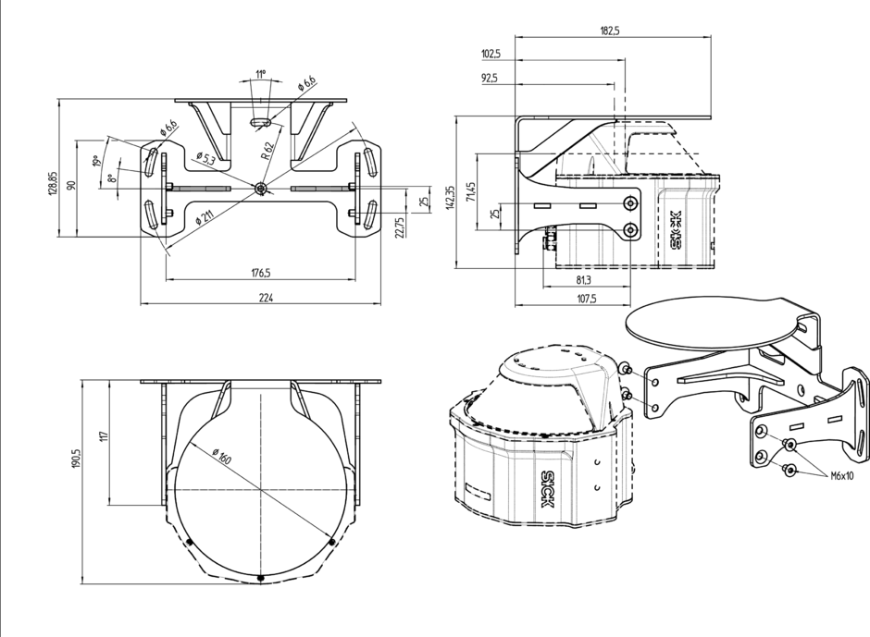
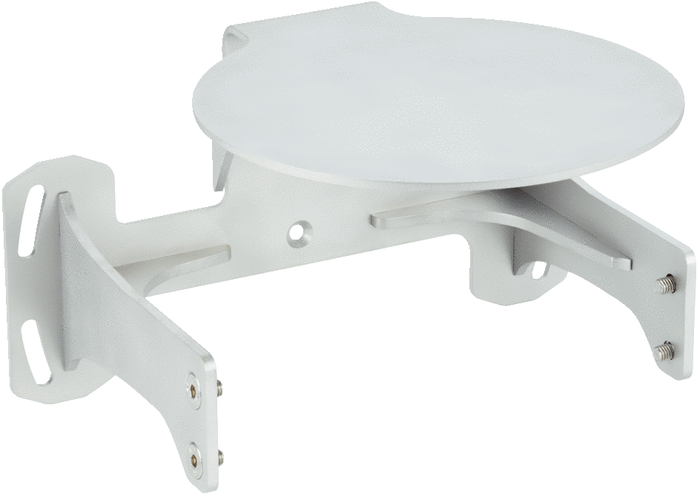
2102121 Mounting kit with impact protection for rear mounting
Mounting kit
Part no.:
    2102121
Description:
    MRS6000 bracket
    for impact protection

Slide 4
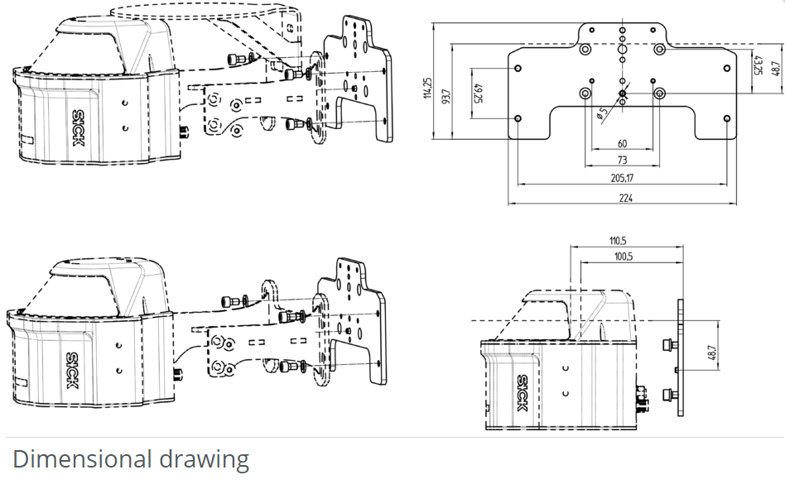
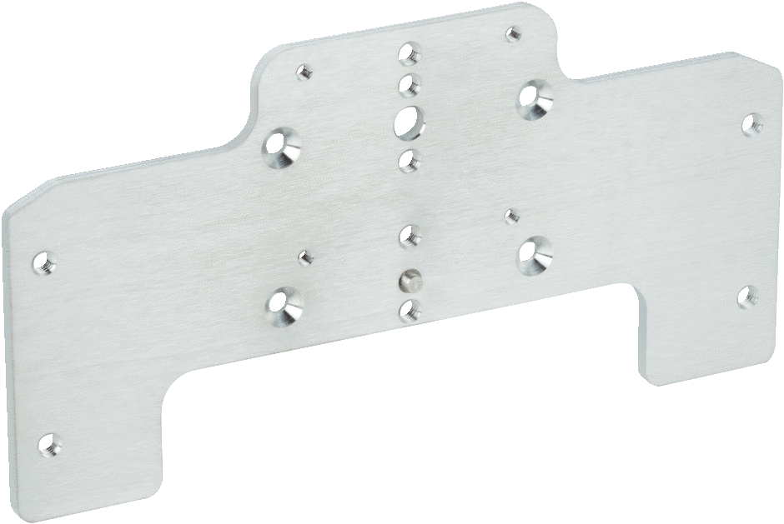
2102124 Adapter plate
Adapter plate
Part no.:
    2102124
Description:
    Adapter plate for mounting the MRS6000 to accessory components

Slide 5
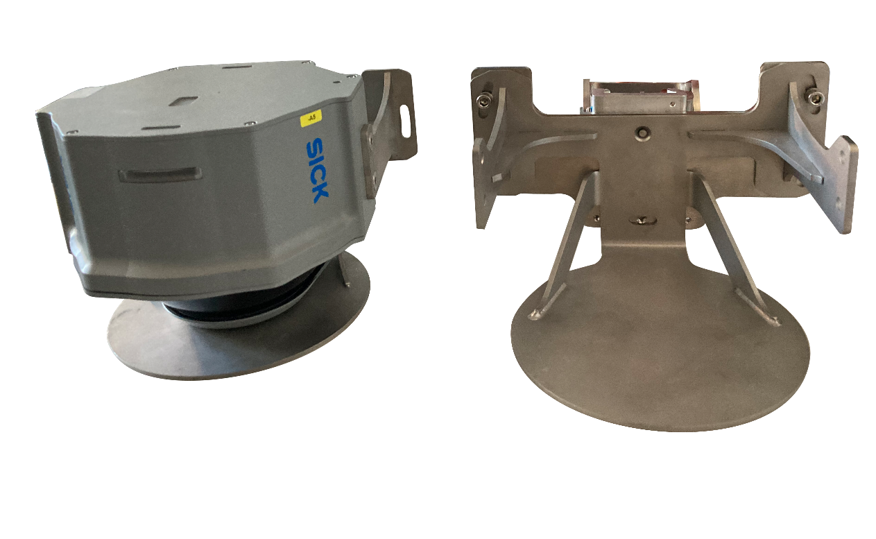
Option 1: Mounting bracket with quick release

Slide 6
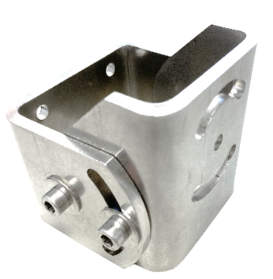
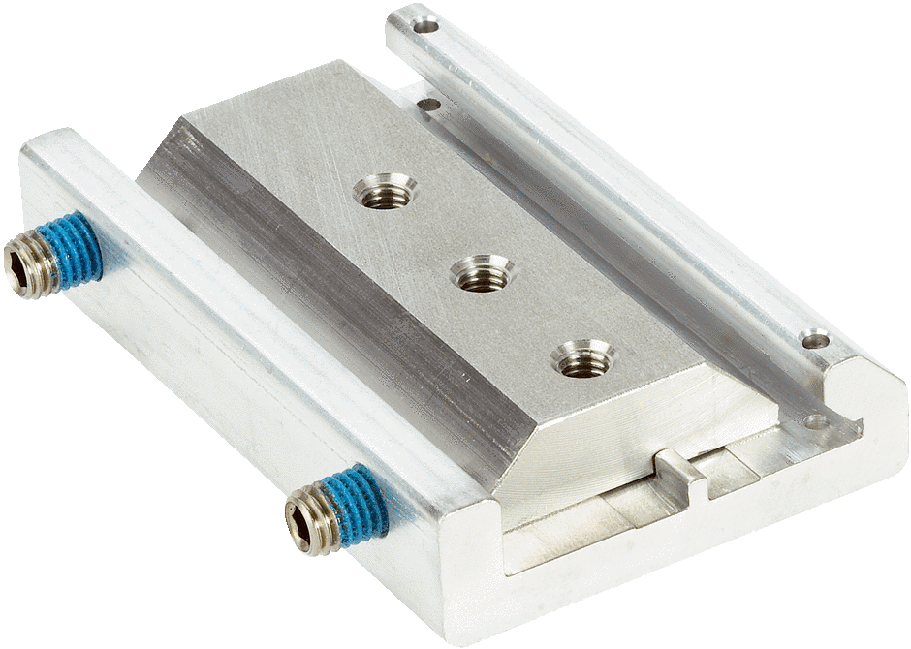
Option 1: Mounting bracket with quick release
Mounting kit
Part no.:
    2102120
Description:
    MRS6000 bracket
or
              MRS6224R-131001
Mounting bracket
Part no.:
    2046025
Quick release
Part no.:
    2046989
Adapter plate
Part no.:
    2102124
Description:
    Adapter plate for mounting the MRS6000 to accessory components
Mounting kit
Part no.:
    2102121
Description:
    MRS6000 bracket
    for impact protection

Slide 7
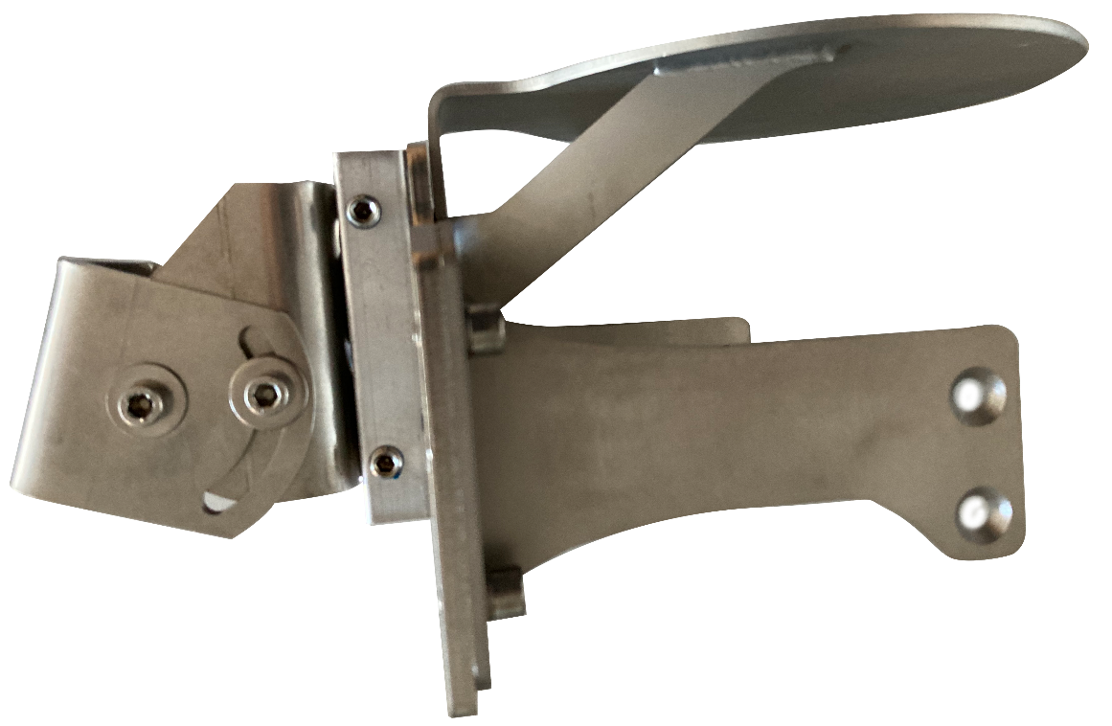
Option 1: Mounting bracket with quick release
View angle adjustable through the mounting bracket
Quick release for a fast mounting or changing of the sensor
Sensor mounted downwards

Slide 8
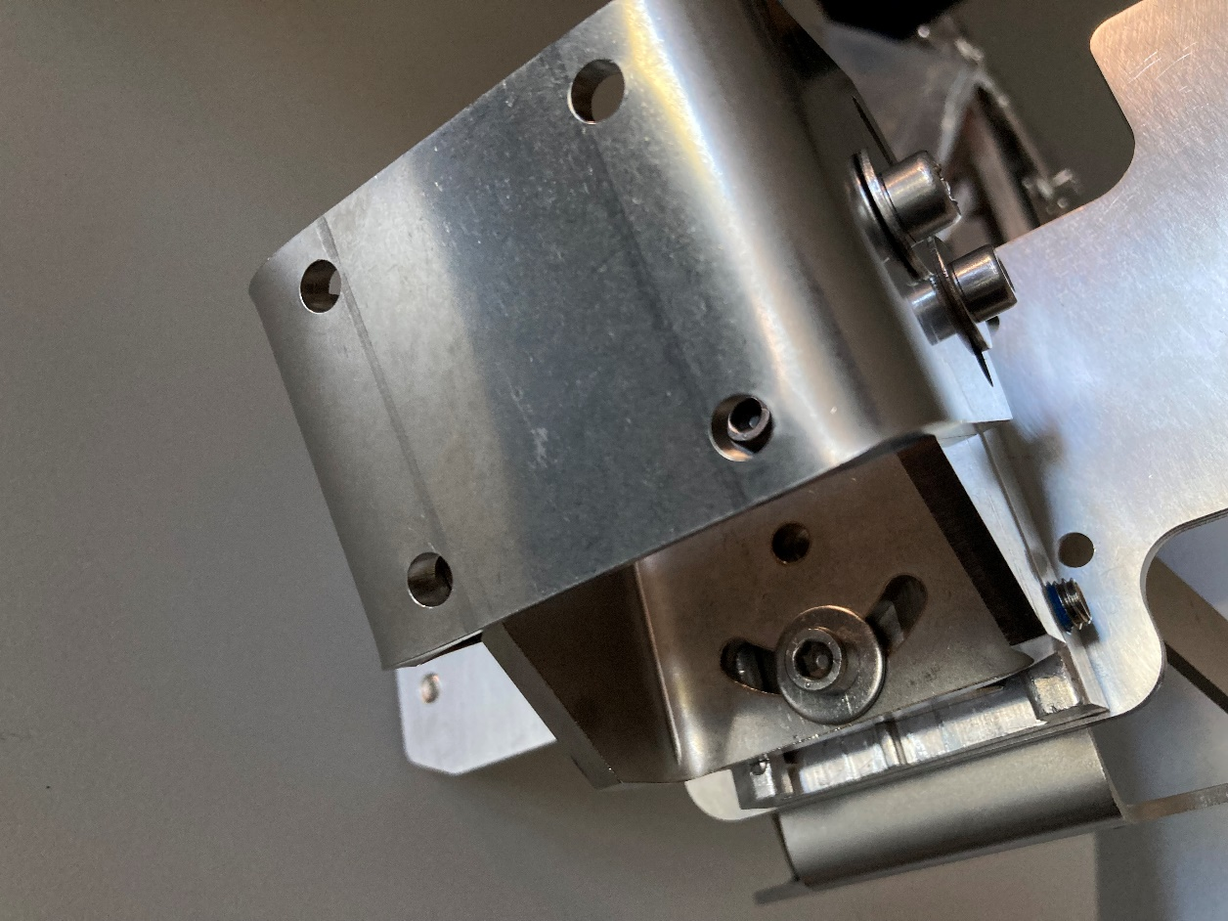
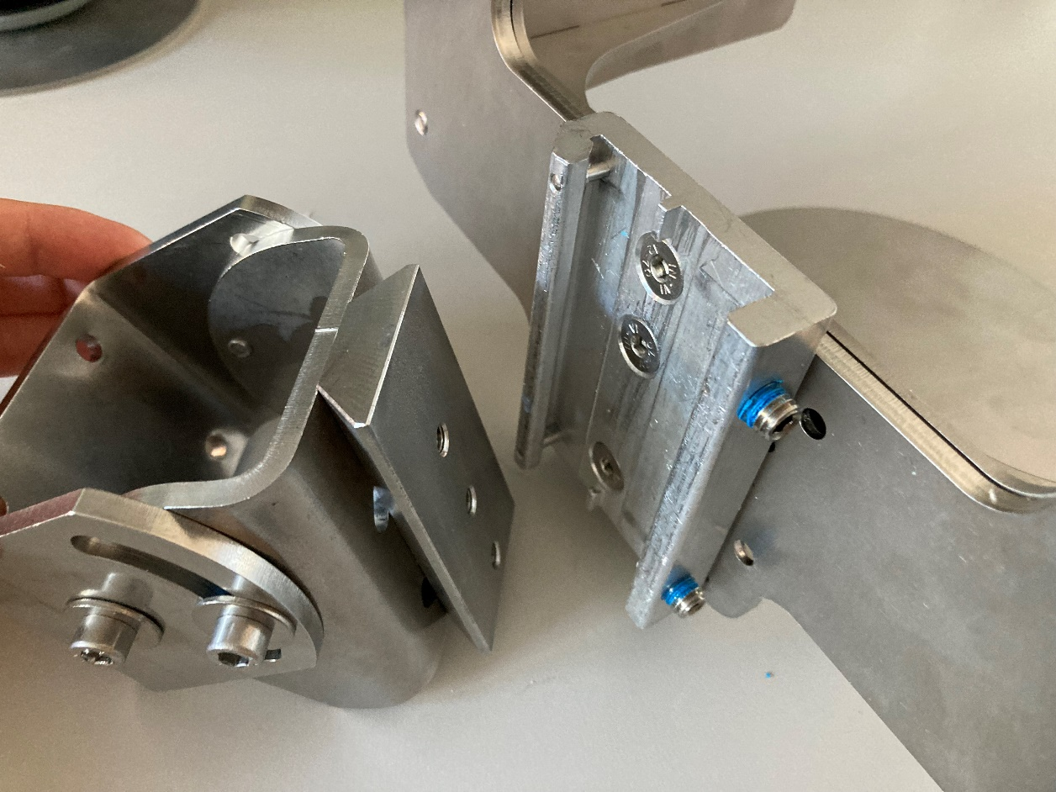
Option 1: Mounting bracket with quick release
The mounting bracket can be attached with four screws to the machine or wall
The bracket also allows the angle of the 2nd axis to be adjusted.
To detach the sensor from the bracket, only two screws need to be loosened

Slide 9
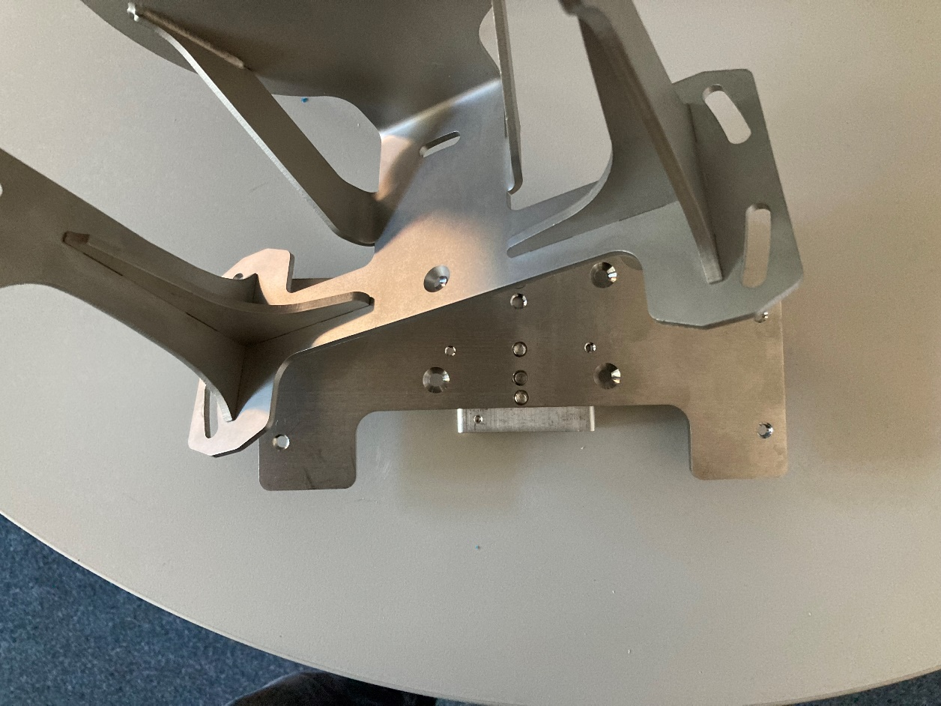
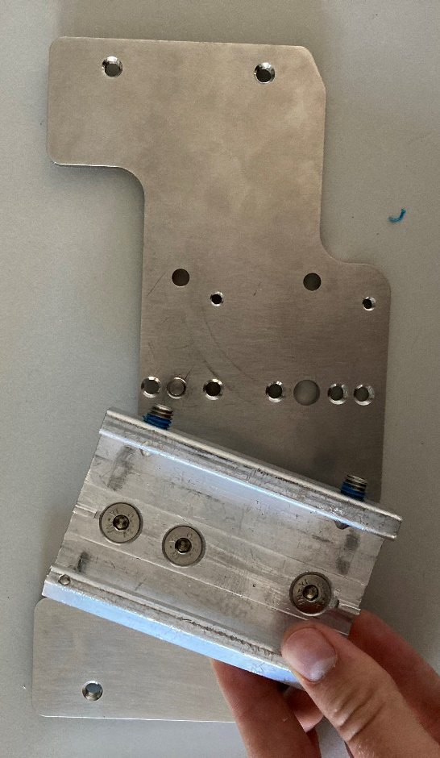
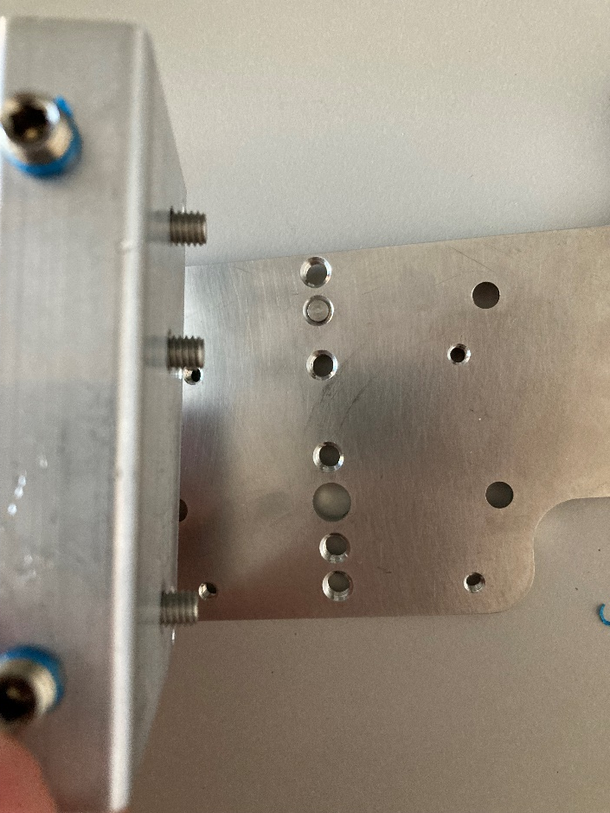
Option 1: Mounting bracket with quick release
The sensor mount is attached to the adapter plate by up to five screws
For decreasing the impact of vibrations and shocks shock absorbers could be deployed between these two parts
The quick release is mounted on the adapter plate by three screws

Slide 10
2046989 Quick release
Quick release
Part no.:
    2046989

Slide 11
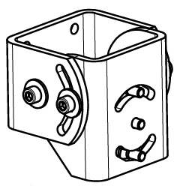
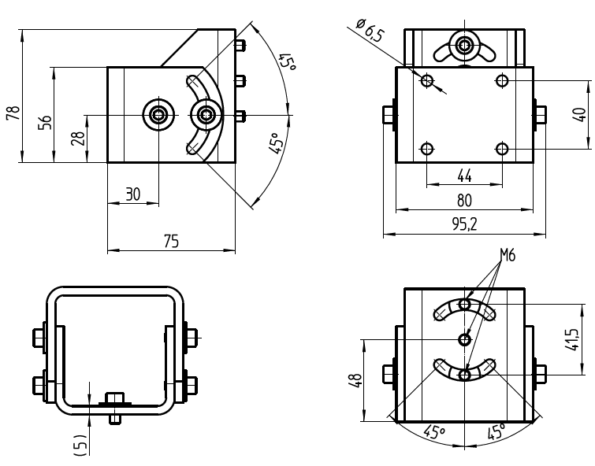
2046025 Mounting Bracket
Quick release
Part no.:
    2046989

Slide 12
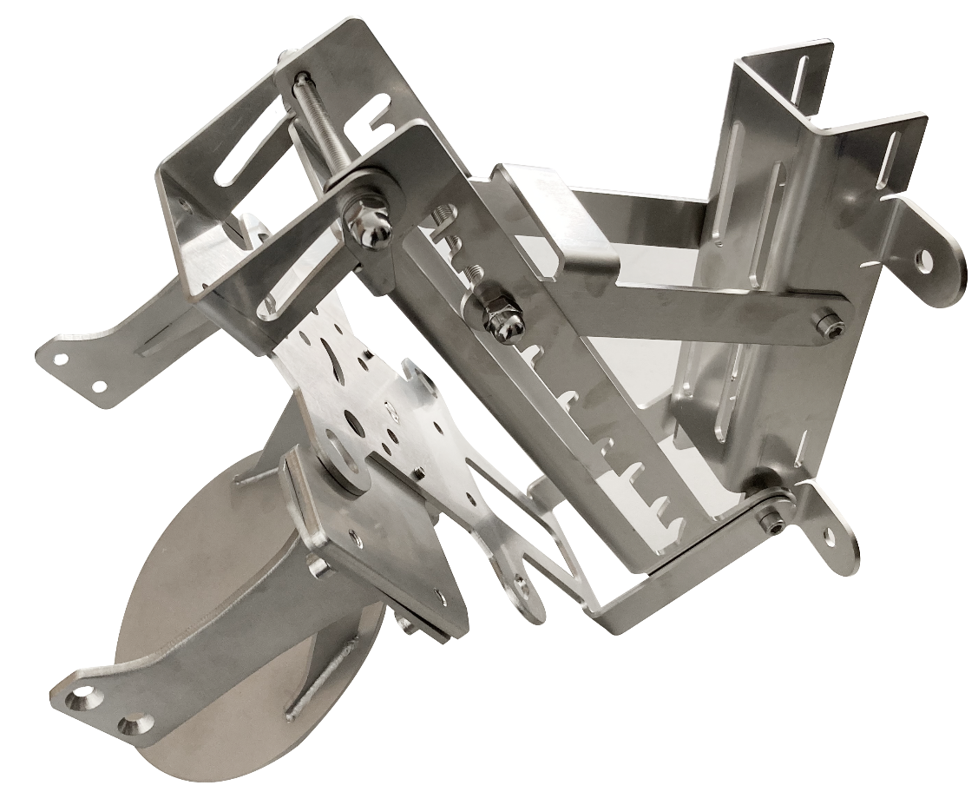
Option 2: Mast mount / wall mount

Slide 13
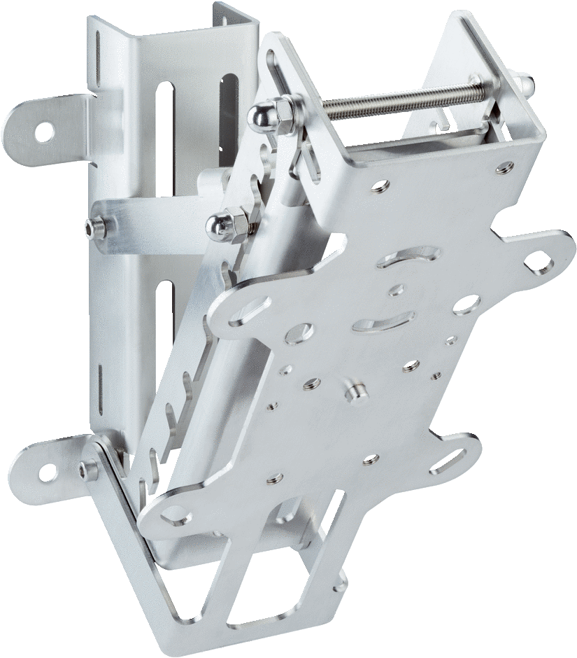
Option 2: Mast mount / wall mount
Mounting kit
Part no.:
    2102120
Description:
    MRS6000 bracket
or
Mast mount
Part no.:
    2079939
Description:
    Mast mount. When mounting with tightening straps, suitable for mast diameter of 95 mm or greater.
Adapter plate
Part no.:
    2102124
Description:
    Adapter plate for mounting the MRS6000 to accessory components
              MRS6224R-131001
Mounting kit
Part no.:
    2102121
Description:
    MRS6000 bracket
    for impact protection

Slide 14
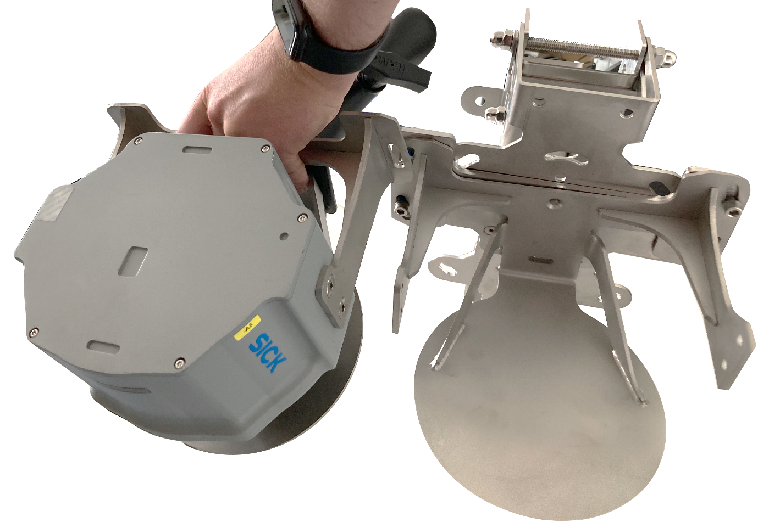
Option 2: Mast mount / wall mount
Fine angle adjustment
Rough angle adjustment
Mounting on crane
Angle of the sensor is variable through the adjustment possibilities of the mast mount
MRS6000 mounted downwards

Slide 15
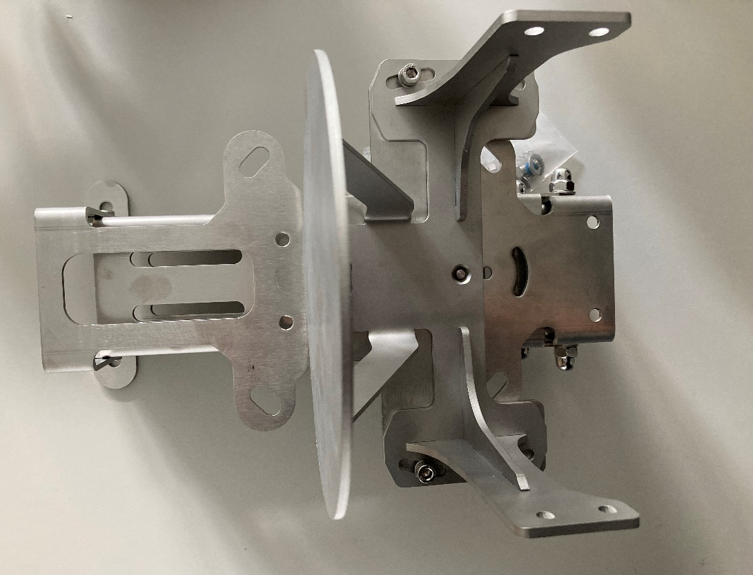
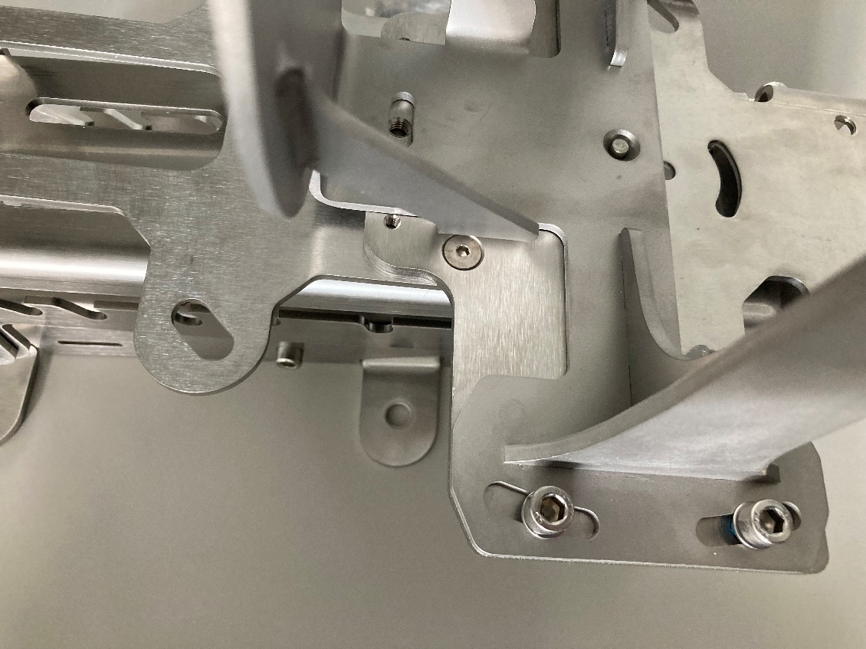
Option 2: Mast mount / wall mount
Mounting on crane
In total 5 screws between adapter plate
Fine adjustment by turning the mount for a few degrees according to the screw holes

Slide 16
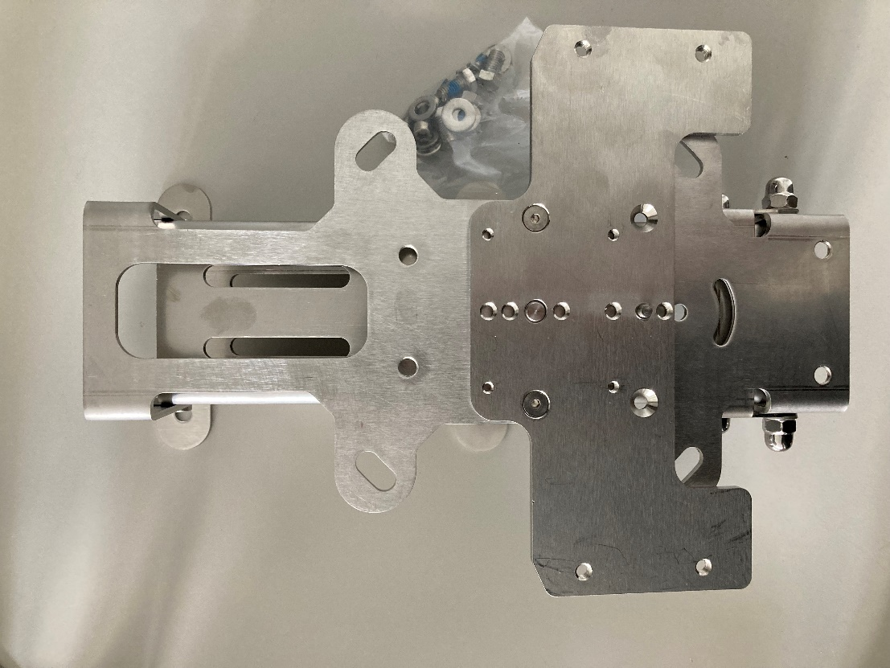
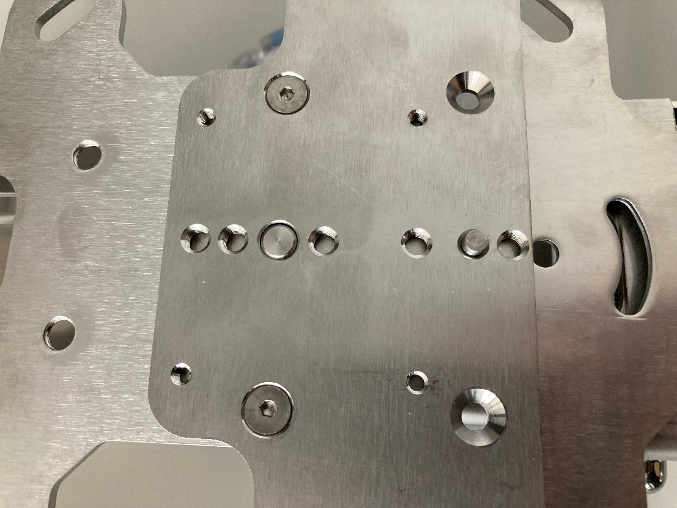
Option 2: Mast mount / wall mount
Mast mount with adapter plate for the MRS6000 mount
Drawback: Only two screws between adapter plate and mast mount
Could be an issue in terms of vibration?

Slide 17
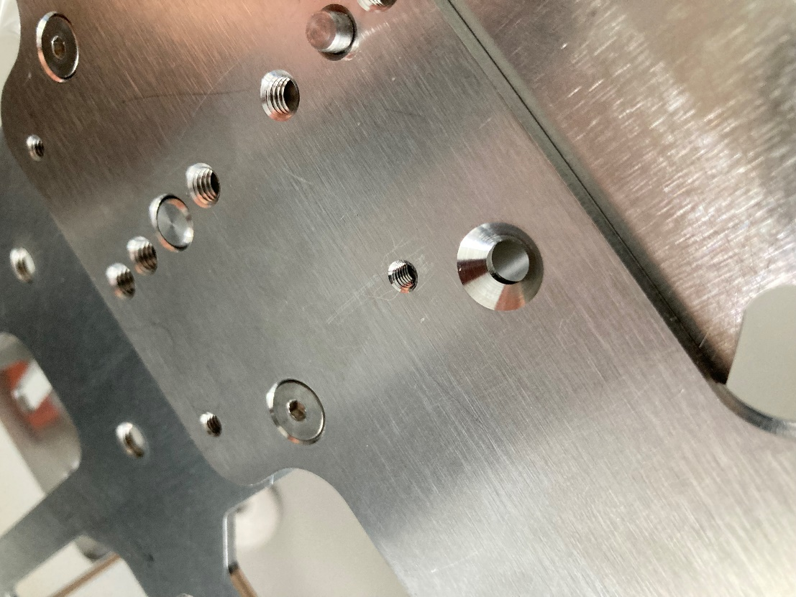
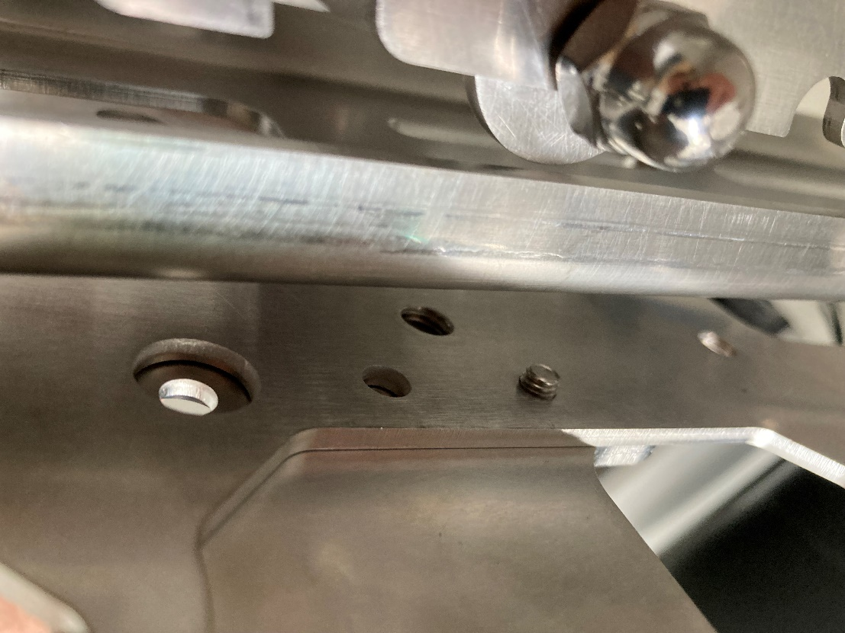
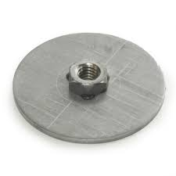
Option 2: Mast mount / wall mount
Possible solution: Remaining two screw holes of the adapter plate could be used for connection to the mast mount by means of a slim washer and a nut

Slide 18
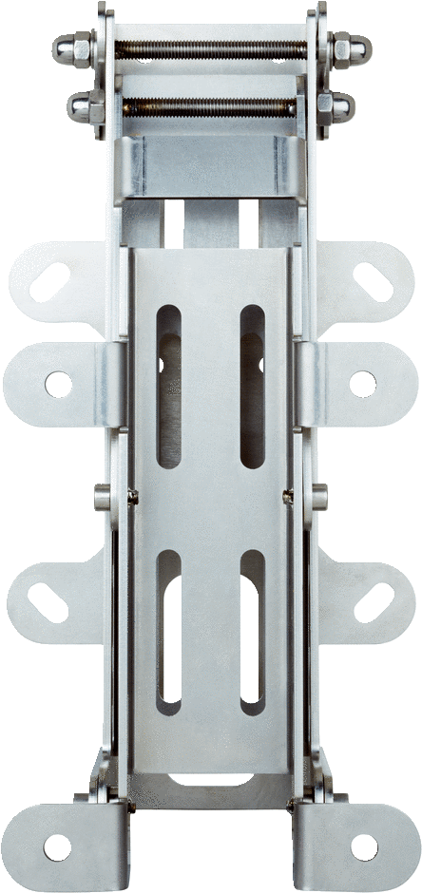
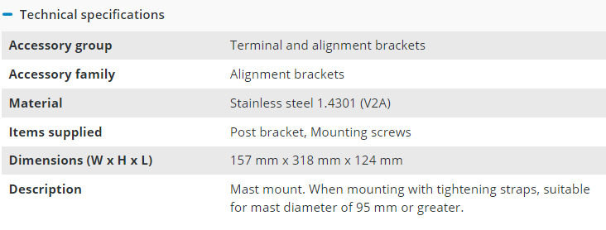
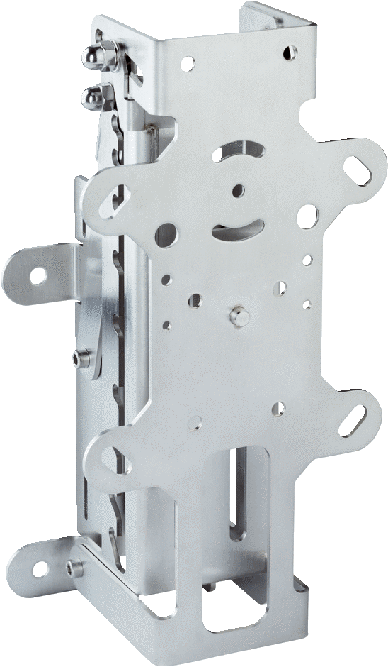
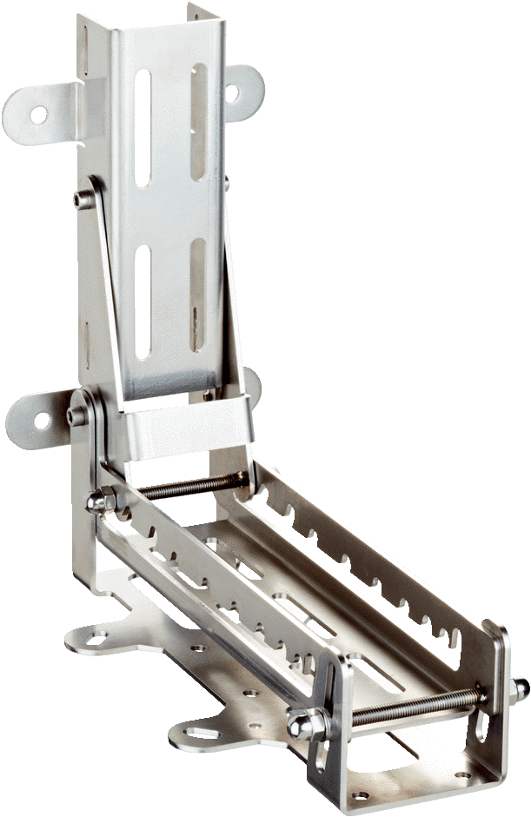
2079939 Mast mount
Mast mount
Part no.:
    2079939

Slide 19
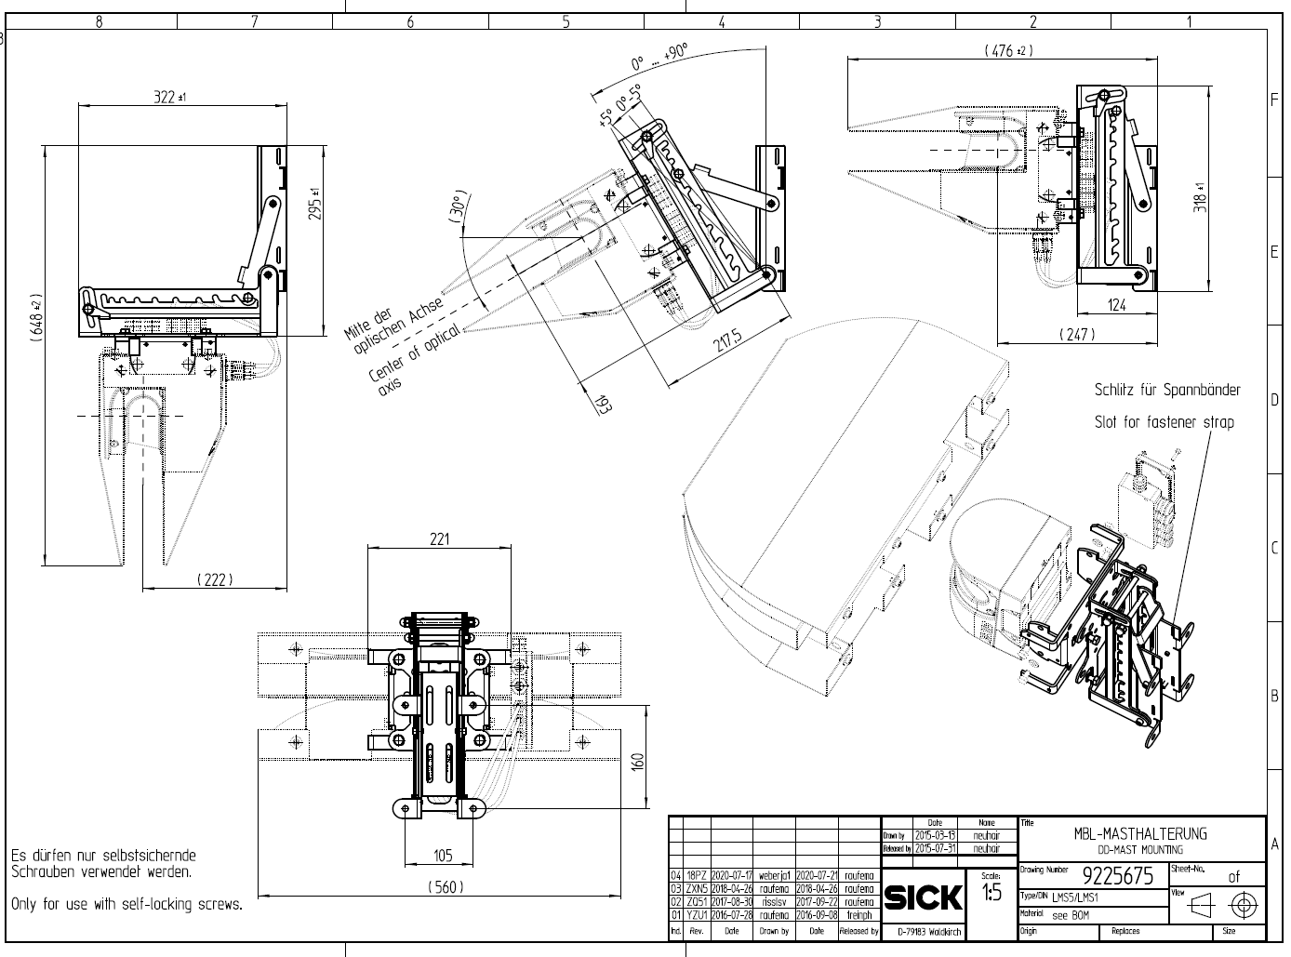
2079939 Mast mount
Mast mount
Part no.:
    2079939

Slide 20
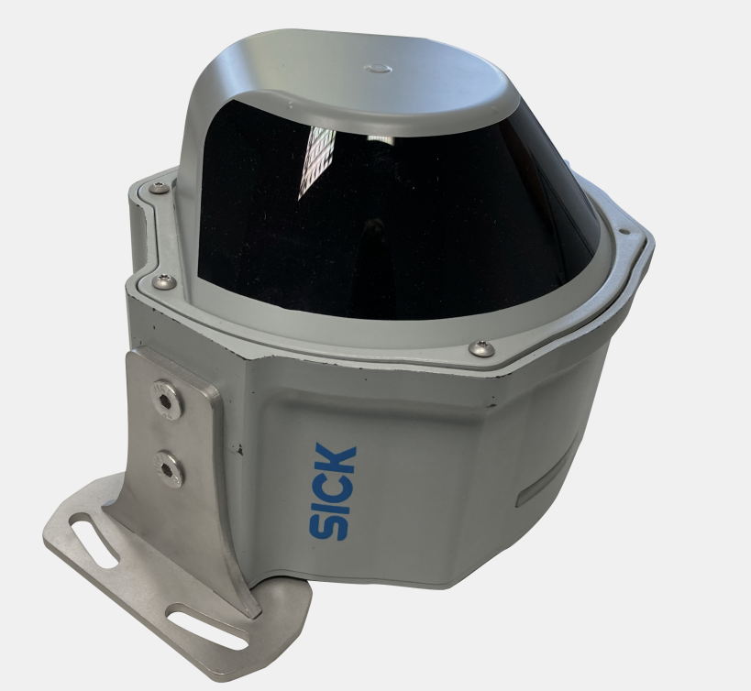
Option 3: Upright mounting

Slide 21
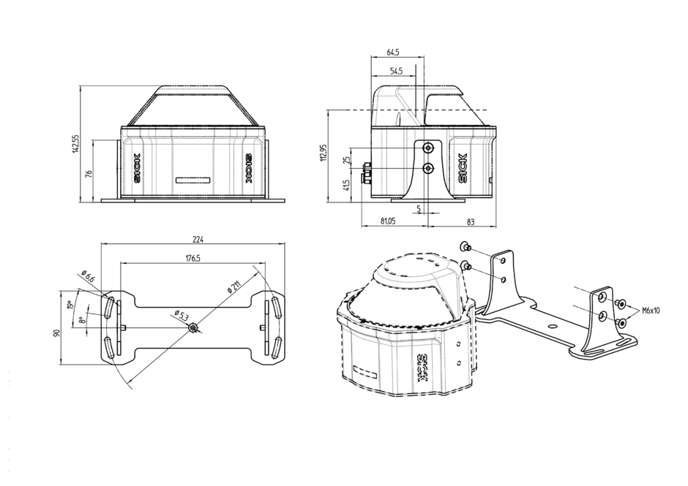
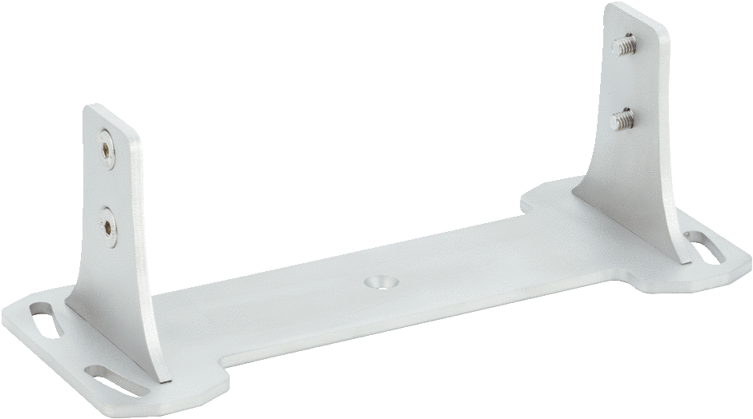
Option 3 : Sensor bracket for upright mounting
Mounting kit
Part no.: 2102119
Description:
    MRS6000 bracket
    for upright mounting

Slide 22
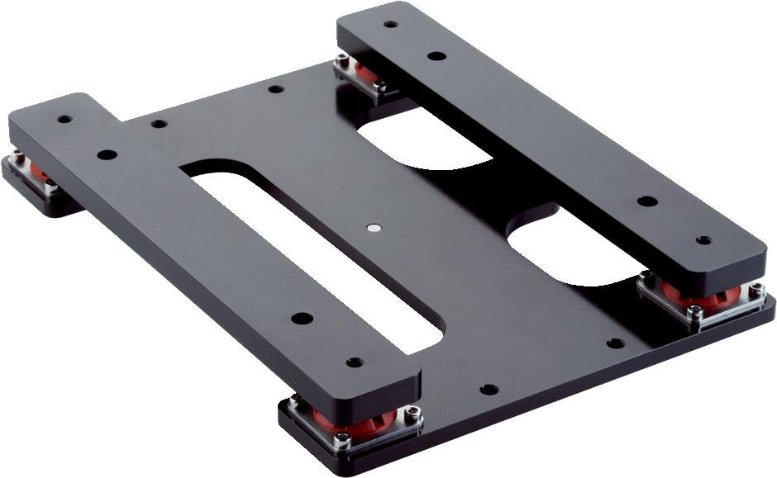
Additional accessory : Shockabsorber / Isolator
Mounting kit shock absorber
Part no.:
    2106367
Description:
    Shock absorber / Isolator

Slide 23
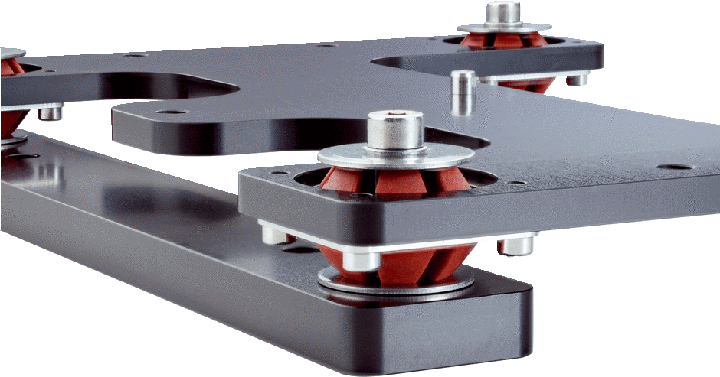
2106367 Shock absorber / Isolator
Mounting kit shock absorber
Part no.:
    2106367
Description:
    Shock absorber / Isolator
Sensor
Back (connection to the wall or machine)
Front (connection to the sensor mount)

Slide 24
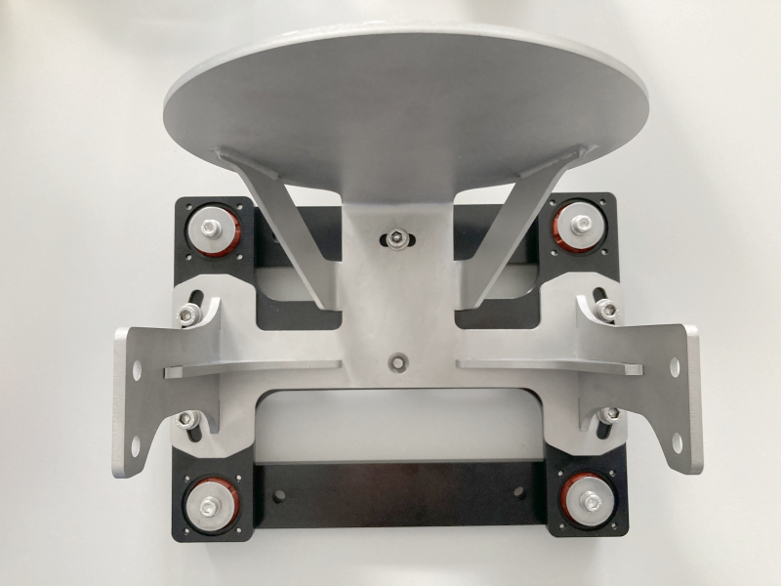
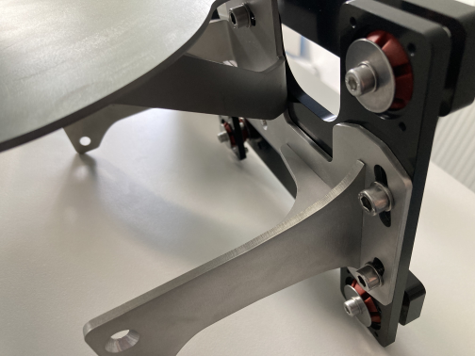
1. Shockabsorber / Isolator : Rear mounting

Slide 25
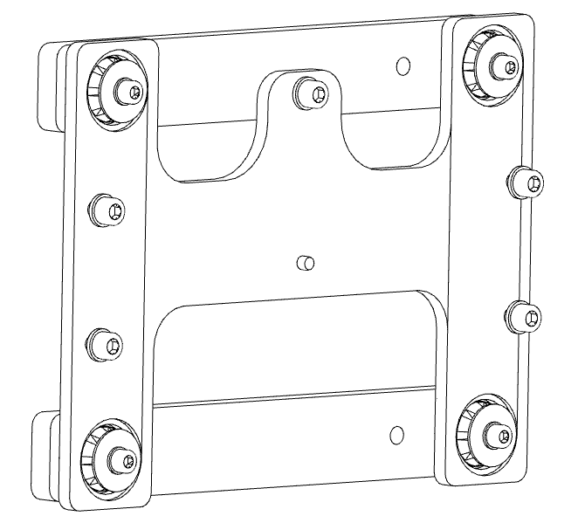
1 Shockabsorber / isolator with rear mounting
Mounting kit
Part no.:
    2102120
Description:
    MRS6000 bracket
or
              MRS6224R-131001
Mounting kit shock absorber
Part no.:
    2106367
Description:
    Shock absorber / Isolator
Mounting kit
Part no.:
    2102121
Description:
    MRS6000 bracket
    for impact protection

Slide 26
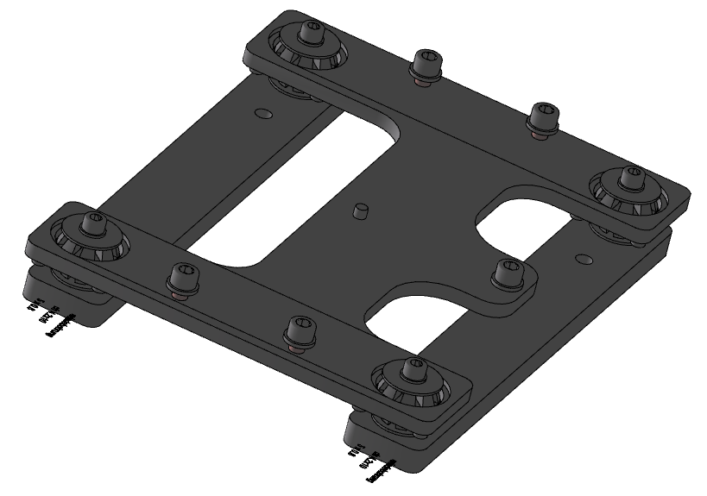
2. Shockabsorber / isolator with Upright mounting

Slide 27
2. Shock absorber with upright mounting
Mounting kit
Part no.: 2102119
Description:
    MRS6000 bracket
    for upright mounting
Mounting kit shock absorber
Part no.:
    2106367
Description:
    Shock absorber / Isolator

Slide 28
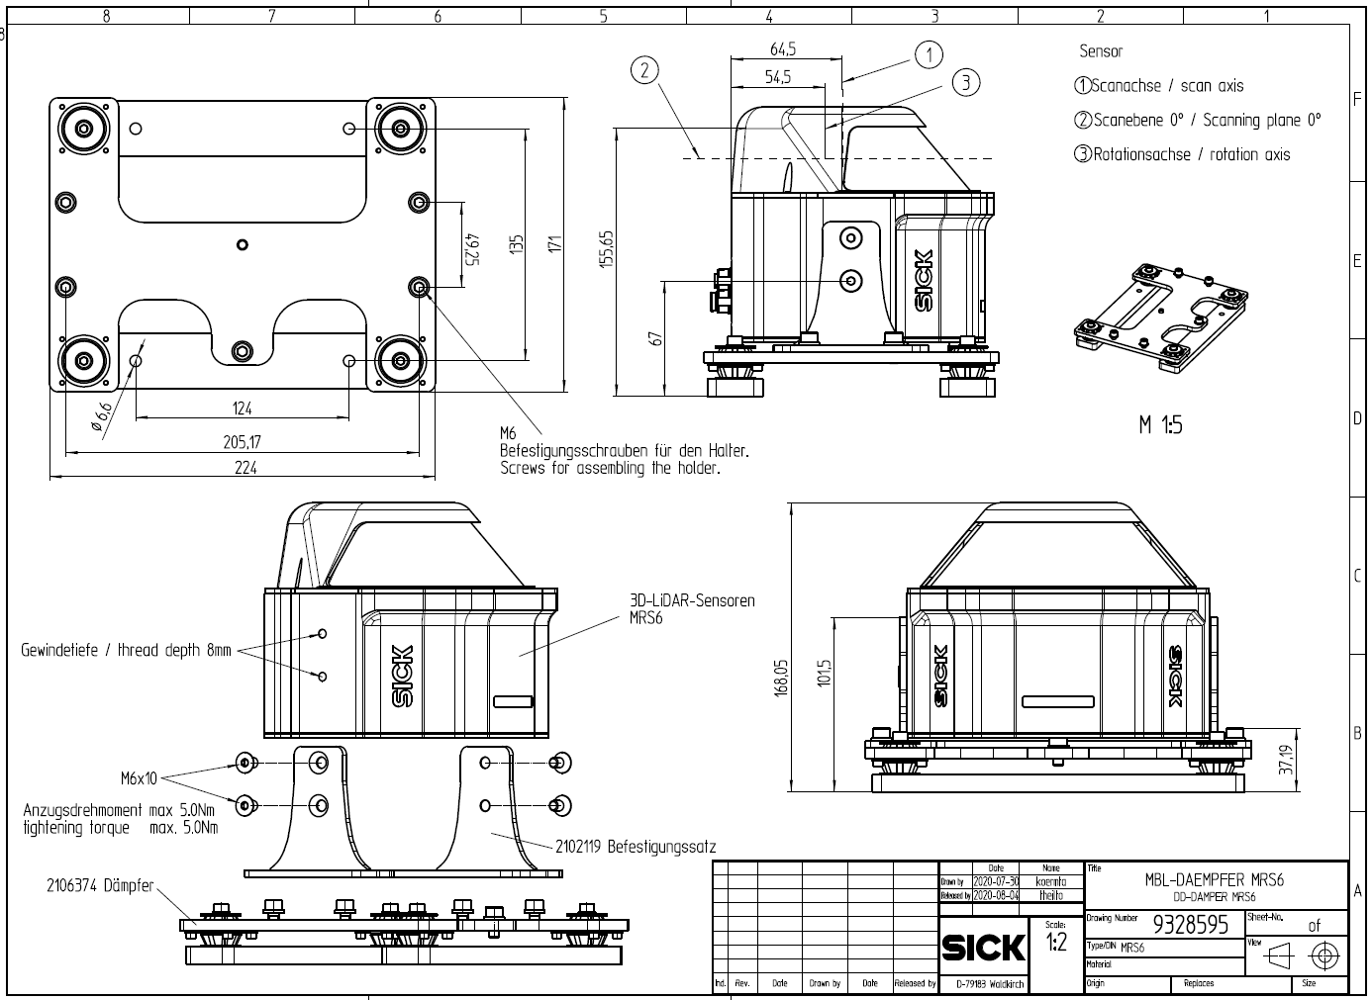
2. Shock absorber with upright mounting

Slide 29
Further accessories

Slide 30
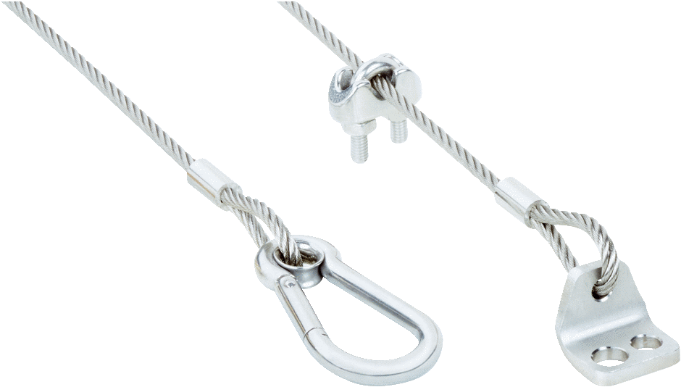
2104795 Retaining cable
Retaining cable
Part no.:
    2104795
Description:
    Steel rope

Slide 31
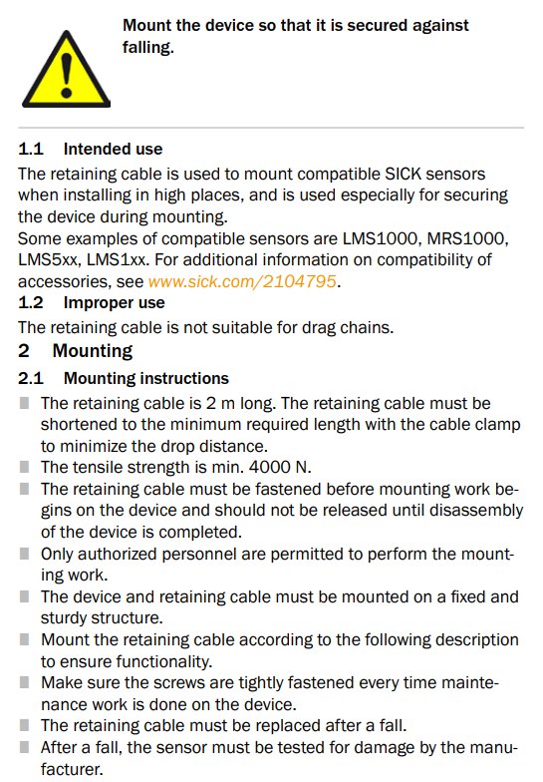
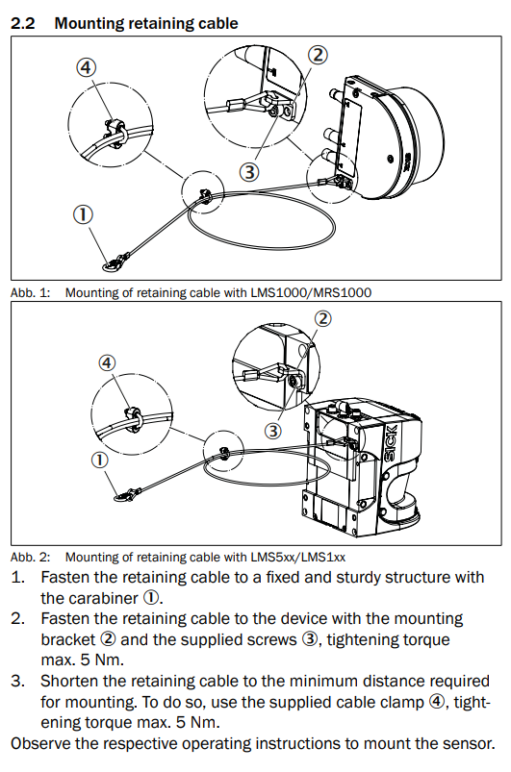
2104795 Retaining cable

