Slide 1
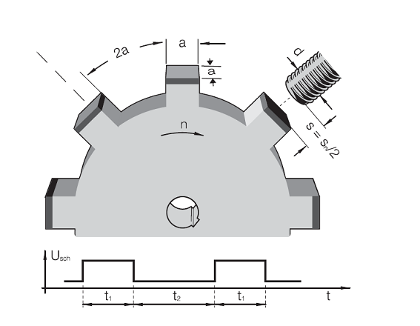
Recommendation for dimensions of a toothed wheel
Switching Frequency f
Is the maximum possible switching sequence per second.
The ratio between „target“ (metal)
and no target (no metal) is 1:2.
The maximum switching frequency is reached when:
  the „switch on“ signal t₁=50µs
  or
  the „switch off“ signal t₂=100µs
The distance sensor to target is Sn/2.
The heigth of the teeth should be >=2xSn
If you go further away from the target, the switching frequency gets higher because the oscillator does not need to ramp up so much.
Notes:
The values given are all derived from the sensor standard
The switching frequency indicates the max. possible changes/sec from energized to unenergized status

