Slide 1
LMS4000 – Get Started With
Scan DATA

Slide 2
LMS4000 – Get Started With Scan DATA
Intro
In this video tutorial, we’ll show you how to pull a scan from the LMS4000.
What you need:
LMS4000 & Wiring cable (Link)
SOPAS ET (Link)
Optional:
- Telegram Listing (Link)

Slide 3
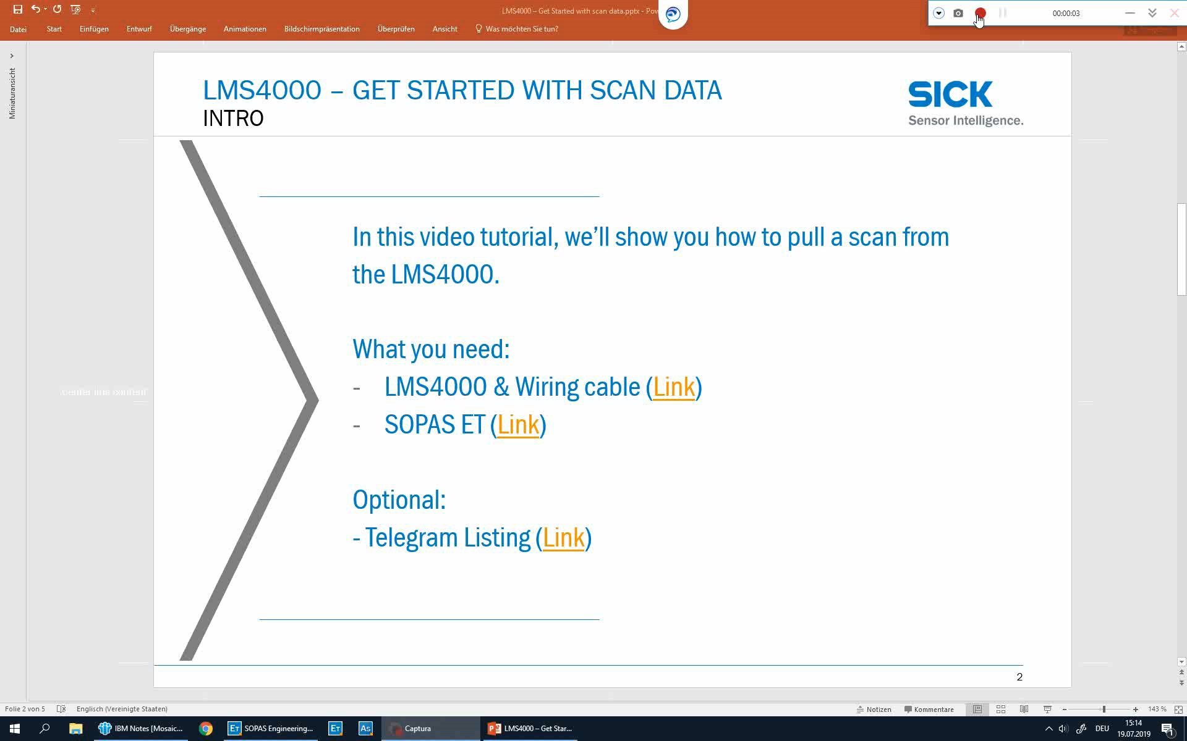
LMS4000 – Get Started WITh Scan DATA
Video
Notes:
Note: The SOPAS ET Terminal shows more feedback than described in the Terminal Listing because there is still a running socket connection between the SOPAS GUI and the scanner.

Slide 4
LMS4000 – Get Started WITh Scan DATA
SOPAS Et Terminal Script
$C *** As a script for the Terminal ***
$C *** Set Access ***
$A sMN SetAccessMode 04 81BE23AA
$W 100
$C *** Set Output Range (Example) ***
$A sWN LMPoutputRange 1 341 F4240 1312D0
$W 100
$C *** Pull one Scan ***
$A sRN LMDscandata
$W 100
$C *** Save permanently ***
$A sMN mEEwriteall
$W 100
$C *** Run Mode ***
$A sMN Run
$W 100
$C *** As a script for the Terminal ***
$C *** Set Access ***
$A sMN SetAccessMode 04 81BE23AA
$W 100
$C *** Reboot ***
$A sMN mSCreboot
$W 100
Example: Change parameter & pull on scan
Example: Reboot the device
These scripts scan be used in the SOPAS ET Terminal.

Slide 5
For technical questions please use:
https://supportportal.sick.com/

